Slide 1


पुनस्थापकीय न्यायको अवधारणा र बालन्यायमा
यो अवधारणाको प्रयोग

Slide 2
प्रस्तुतिमा समेटिएका विषयहरु
पुनस्थापकीय न्यायको अवधारणा
अवधारणागत रुपमा प्रस्थानका विषयहरु
परम्परागत फौजदारी न्याय प्रणालीसंगको भिन्नता
अवधारणागत विका
प्रचलित अभ्यासहरु
नेपालको बाल न्यायप्रणालीमा प्रयोगको सम्भावना

Slide 3
पुनस्थापकीय न्यायको अवधारणा
Restorative justice is a process whereby parties with a stake in a criminal offense (including the offender, the victim, and the communities of each) collectively resolve how to deal with the aftermath of the criminal act with an emphasis on repairing the harm from that act – the harm to the victim, to the community, and to the offender her/himself.
- Donald J. Schmid (RJ in New Zealand: A Model for US Criminal Justice )
Restorative Justice focuses on the harm caused by the crime, repair of that harm, and reduction of future harm by preventing future crime.

Slide 4
RJ in Child Justice
RJ means an approach to justice that aims to involve the child offender, the victim, the families concerned and community members to collectively identify and address harms, needs and obligations through accepting responsibility, making restitution, taking measures to prevent a recurrence of the incident and promoting reconciliation.
- Sec. 1 of Child Justice Act, 2008 of SA

Slide 5
RJ as the Repairing Justice
Restorative justice is every action that is primarily oriented toward doing justice by repairing the harm that has been caused by a crime
  what do we mean by a "harm caused by a crime?"
  who (and what) shall we consider as suffering that harm ?
  how can that harm be repaired ?
  what is "justice" and how can it be achieved ?

Slide 6
Understanding
Harm : all kinds of harm, including material losses, physical injuries, psychological consequences, relational problems and social dysfunctions
Victim : injuries and losses inflicted on the individual victim and his intimates are most concrete. But whether community should also be considered a victim (Christie, 1982).
(some fear that recognizing society as a victim will bring about a return to the retributive focus, wherein the state has set itself up as the primary victim, thereby pushing the individual victim into a subordinate position).
The Restoration :
  Outcome : restitution, compensation, service to victims, apologies etc.
  Process : voluntary v involuntary

Slide 7
Process
Voluntary - face to face conferences between the victims and the offender
However, it limits the scope of the RJ
  would exclude from the opportunity who chose not to become involved in such meetings
  would also exclude those victims whose offender is unknown and who may simply want information and compensation
Coercive - formal criminal sanctions such as court ordered mediation and community service. Sanctions are restorative to the extent that they are carried out with the intent to repair harm and maximize the satisfaction to victims and community but may be experienced as painful by offenders.
        - indirect participation of victims

Slide 8
Understanding
Doing Justice
  Restorative justice is not only about restoration; it is also about "justice"
  Justice has three meanings
    it refers to a feeling of equity, of being treated in a similar way as others in similar circumstances
    also means optimal satisfaction of all parties with a stake in the offense (Victims should feel that their victimization has been taken seriously, that they had the opportunity to express their anger and fear, that they have been supported by the community and that care has been taken to address their losses. Offenders should receive a clear message that they have transgressed the limits of social tolerance and they have an opportunity to make up for their lapse in a reasonable and constructive way. Communities should be strengthened by the restorative process and experience reduced fear and a greater sense of efficacy and social cohesion, as well as satisfaction that crime and offenders have been sanctioned, safety and security enhanced, and offenders reintegrated in an acceptable way.
    justice also refers to legal protection of the individual against unwarranted intrusion by the state. Process and outcomes must respect those legal safeguards to which all citizens are entitled.

Slide 9
Basics
The basic concept behind restorative justice is that the offender and the victim still live in the same community, and thus need to find a way to move forward together.
This requires dialogue, and support of other members of the community. The offender acknowledges the harm to the victim, and takes responsibility for it and for finding a better path forward in life. The victim can help “educate” the offender about the harm that has been caused, and put a human face on it, but also needs to acknowledge that life goes on and it’s important to move forward together as a community

Slide 10
Four main forms of RJ :
Victim offender mediation - Canada : bring together victim and offenders with a mediator
Community reparation Boards - USA : community involvement in reparation
Police led-restorative cautioning - Australia, UK : re-integrative shaming, degrading ceremony but re-integrative ceremony, to make them realize, reparation and apology, Thames Valley Police, UK is famous
Family Group Conferencing - New Zealand : bring together offender, families and community to determine appropriate means of redress for victims, court ordered conferences

Slide 11
However, No Unified RJ Movement
Proponents prefer to use different names –
  transformative justice
  peacemaking criminology
  relational justice
  community justice

Slide 12
अवधारणागत रुपमा प्रस्थानका विषयहरु

Slide 13
Conceptual Departures
Crime is a violation of people and relationships rather than just a violation of law
Violence, community decline, and fear-based responses as indicators of broken relationships
Violations always create obligations
The aim of justice is to identify obligations to meet needs and to promote healing
Justice is collaborative process. Justice involves victims, offenders and the community in search to identify needs and obligations

Slide 14
Conceptual Departures
Considers crime and wrongdoing to be an offense against an individual or community, rather than the State
The primary aim is making amends for the offending, particularly the harm caused to the victim, rather than inflicting pain upon the offender
Accountability is defined as recognizing the wrongfulness of one's conduct, expressing remorse for any resulting injury, and taking actions to repair the damage done by offending
Crime creates positive obligations against the "just desert" theory of justice
Reintegration of both victims and offenders within the community
Different from punishment model and treatment model of criminal justice system

Slide 15
पुनस्थापकीय न्यायको अवधारणागत विकास

Slide 16
What has Fuelled the RJ Movement
The movement towards increased rights for victims
Increasing rates of incarceration
The movement towards greater community involvement in justice process
Concern about recidivist offending
Weakness of Traditional Cr JS

Slide 17
Victims' rights
  Perceived an imbalance in the rights belonging to the accused and the rights of crime victims
  In 1982, the President of the US created a Task Force on Victims' rights
  In the same year, Congress passed legislation allowing victims to provide Victim Impact Statement
  This movement had helped to develop the RJ movement – Joan W. Stickels (Victim Impact Evidence: The Victims' Right That Influences Criminal Trials, 2001)
Incarceration rate
  Father Jim Consedine argued that New Zealand imprisons far too many people at overwhelming costs, 217 per 100, 000 population in 2017
  In October 2013, the incarceration rate of the United States of America was the highest in the world, at 716 per 100,000 of the national population.
  While the United States represents about 4.4 percent of the world's population, it houses around 22 percent of the world's prisoners.

Slide 18
Repeat offending
  80% of persons imprisoned in New Zealand are reconvicted within two years of their release from prison (See Ministry of Justice, Recidivism Patterns for People Convicted in 1995 at 9(2001)
  Within three years of release, about two-thirds (67.8 percent) of released prisoners were rearrested in US
  Within five years of release, about three-quarters (76.6 percent) of released prisoners were rearrested in US

Slide 19
Community involvement
  Conventional Cr JS fails to stimulate any sense of respect for offenders and victims
  Lay people are often better placed to bring emotions such as through the communication of sympathy for victims, or re-integrative shaming of offenders
  Adds legitimacy to the proceedings.
  Can build social capital, solidarity and commitment to shared values
Weakness of Traditional Cr JS
  Sending the kid to jail or sending him to the beach
  Punishment and Treatment model not sufficient

Slide 20
History
Two different streams –
  Australia, New Zealand and Canada
  Restorative justices is used to describe a variety of ancient indigenous dispute resolution practices associated with Aboriginal groups
  US and Europe
  Restorative justice has been associated primarily with one practice, victim- offender mediation
The first “Victim Offender Reconciliation Program” was started in Kitchener, Ontario, Canada in 1976; the first VORP in the United States was started in Elkhart, Indiana in 1978. In 1990, there were approximately 150 such programs; in 2000, there are more than 1200 programs world-wide.

Slide 21
History
The first Victim-Offender Reconciliation Programme (referred to here as VOM) began as an experiment in Kitchener, Ontario in the early 1970's (Peachey, 1989 at 14-16) when a youth probation officer convinced a judge that two youths convicted of vandalism should meet the victims of their crimes. After the meetings, the judge ordered the two youths to pay restitution to those victims as a condition of probation. Thus, VORP began as a probation-based/post-conviction sentencing alternative inspired by a probation officer's belief that victim-offender meetings could be helpful to both parties.

Slide 22
History
The term restorative justice was probably first used by Albert Eglash. He had written an article in 1959 entitled "Creative Restitution' and later in 1977 he wrote an article entitled “Beyond Restitution: Creative Restitution”.
The term "restorative justice" was likely coined by Albert Eglash in 1977

Slide 23
History
Howard Zehr's book Changing Lenses–A New Focus for Crime and Justice, first published in 1990, is credited with being "groundbreaking", one of the first to articulate a theory of restorative justice
By the second half of the 1990s, the expression "restorative justice" had become popular, evolving to widespread usage by 2006
According to Howard Zehr, "Two peoples have made very specific and profound contributions to practices in the field – the First Nations people of Canada and the U.S., and the Maori of New Zealand...
the Maori had a well-developed system called Utu that protected individuals, social stability and the integrity of the group

Slide 24
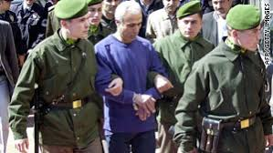
Pope John Paul II को हत्या प्रयास
सन्१९८१ मा Pope John Paul II लाई Mehmet Ali Agca ले हत्या गर्ने उद्देश्यले गोली प्रहार गरेका थिए । कारवाही स्वरुप जेलमा परे । सन् १९८३ मा जोन पाउल द्बितीयले जेल मै गएर आफ्नो हत्या प्रयास गर्ने अपराधीलाई भेटे र माफि दिंदै कैद मिनाहाका लागि अनुरोध पनि गरे ।माफि त दिइयो तर पहिल्यै गरेको अर्को अपराधको लागि टर्कीमा सपुर्दगी गरियो ।पछि २०१४ मा कैद मुक्त भए पछि Mehmet Ali Agca पुन: इटालीमा आए । तर यस पटक गोली प्रहार गर्न होइन, जोन पाउल द्बितीयको समाधीमा फूल चढाउन ।

Slide 25
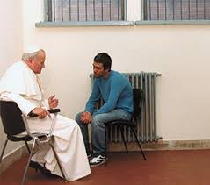

Slide 26
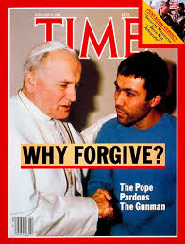

Slide 27
RJ Example
In South Africa, husband of a wife was killed by somebody, he had a wife and a kid, there was nobody to take care of widow and her kid, she had a huge farm but no capacity to grow agriculture in her land. Then accused was ordered by the court to grow crops for the widow and her child in addition to the punishment.

Slide 28
Sentencing Model
Punishment Model
Treatment Model
Restorative Model

Slide 29
Use in Adult Crimes
For the first time in 1994, the restorative justice process was extended to adult offenders in New Zealand

Slide 30
परम्परागत फौजदारी न्याय प्रणालीसंगको
भिन्नता

Slide 31
Difference from Retribution
Retributivist primarily consider the harm to be of an abstract judicio-moral order, which creates an imbalance that must be corrected by an equal harm to the offender. Under the restorative justice too, crime is defined by the harm however, the primary reaction against it is not to punish but to repair or compensate for the harm caused by the crime.
RJ is based on a trauma model which theorizes that committing trauma is traumatizing to the perpetrator. That inflicting trauma is a double edged sword. At least for perpetrators who have the capacity to experience empathy, who are not psychopathic. Retributive justice sounds frighteningly like an eye for an eye, which leaves everyone blind in the end. In other words, everyone is traumatized

Slide 32
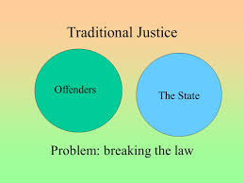

Slide 33
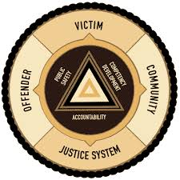

Slide 34
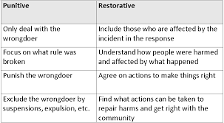

Slide 35
Difference from Rehabilitation
Restorative justice concerned with the harm caused to the victims and the remedy is to repair or compensate for the harm caused by the crime. The rehabilitative models do not focus on harm, but, using these terms, it could be said that they try to redress harm to the offender caused by socio-psychological misfortunes that occurred before the offense was committed.

Slide 36
Difference between Restorative Justice and Rehabilitative Justice
Rehabilitative justice focuses on the offender; restorative justice focuses on the victim.
Offenders are made to attend counseling, drug and alcohol rehab programs, job training, etc. in an effort to steer them away from a criminal lifestyle.
Restorative justice tries to make the victim whole (recovered) again. The only benefit to the offender is that they possibly feel remorseful as they are made to appreciate the damage they have done (don’t count on this happening much). Offenders are made to pay restitution to victims

Slide 37
Difference from Rehabilitative Justice
Rehabilitative justice focuses on the perpetrator as the patient or client to "fix". The treatment goal is to change the perpetrator into a non-offending productive citizen.
The focus of restorative justice is on the victim. How to make the victim "whole" and how the perpetrator can assist in that process. The theory is that in the process of restoring wholeness to one's victim, the perpetrator also is restored to wholeness.
Rehabilitative justice based on treatment model

Slide 38
Difference from Diversion
To divert the offenders from the strict formal criminal justice process
To be dealt with outside the court system
To avoid getting a criminal record
No need of victim's consent or participation
Restorative Justice attempts to deal with the harm through a discussion but diversion is the alternative scheme to deal with the offenders in an 'out of court' way

Slide 39
पुनस्थापकीय न्यायका आधारभूत सिद्धान्तहरु

Slide 40
Core Principles
Van Ness (1997) has proposed that the foundation of RJ can be built on three principles that flow from the common premise that –
  crime is more than lawbreaking
  it also causes injuries to victims, communities and even to offenders.
If crime is thought of as "peace breaking," the three principles can be stated as follows :
P 1: Justice requires that we work to heal victims, offenders and communities that have been injured by crime.
P 2: Victims, offenders and communities should have the opportunity for active involvement in the justice process as early and as fully as possible.
P 3: We must rethink that relative roles and responsibilities of the govt. and the community. In promoting justice, govt. is responsible for preserving a just order and the community for establishing peace.

Slide 41
Ancillary Principles Proposed by Van Ness (1997)
Encounter : emphasis on making connections among stakeholders in each crime
Reparation : as a debt to victim and the victimized community rather than to the state in the abstract
Reintegration: reintegration of offenders and victims (addressed not only the past but emphasis on "transformation" which provides an even stronger link to the needs of the future.
Participation : participation of all stakeholders

Slide 42
Rationale behind the RJ
If the main aim of the criminal justice system is to maintain peace in the society, RJ approach is the best way instead of traditional cr JS
Even within the Cr JS, the paradigm is being shifted from retribution to reformation. This can be the appropriate one in achieving such objective.
By the term justice, it should be for the victims and communities. Traditional Cr JS ignored the victims and concentrated mainly on offender.

Slide 43
Rationale behind the RJ
Since traditional Cr JS has been failure to deter the potential criminals and to avoid the criminals from the future offenses, the better way would be to make them take responsibility
Just desert philosophy of sentencing may be justified in the sense that punishment should be proportional to the gravity of crime but circumstantial aspect of every crime is different. RJ would be a better way to consider the specific circumstances of a crime and address accordingly.
Sending the offender to jail or sending him to the beach would not be the only choice. RJ is a genuine third way for the justice.
  It is an approach focused neither on punishment nor treatment of offender, but on repairing harm and peaceful resolution of conflict

Slide 44
Rationale behind the RJ
Future welfare is important rather than to punish the past offenses
Political movement to "devolve" justice (Griffiths and Hamilton, 1996) challenged the alienating and authoritarian modalities of criminal courts and proposed that communities be given greater latitude over the sentencing process and the general response to crime.
According to social positivism theory, crime is not the outcome of free will of the offender. There are many social causes that determine the propensity of criminal behaviour. If that is so the only punishment imposed on offender will have no effect to reduce re-offending.

Slide 45
प्रचलित अभ्यासहरु

Slide 46
प्रचलित अभ्यासहरु
Family group conferencing
Victim-offender mediation
Restorative conferencing
Community restorative boards
Restorative circles
Circles of Support and Accountability
Sentencing circles
Rituals of circles

Slide 47
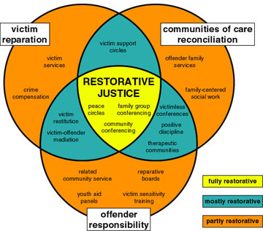

Slide 48
Family Group Conferences
The Children, Young Persons and Their Families Act of 1989 of New Zealand provides
Incorporated Maori concepts and traditions of justice
Maori concept –
  emphasis on reaching consensus and involving the whole community;
  desired outcome was reconciliation and a settlement acceptable to all parties
  the concern was not to apportion blame but to examine the wider reasons for the wrong
  less concern with whether or not there has actually been a breach of the law and more concern with the restoration of harmony

Slide 49
Family Group Conferences
Youth justice coordinator invites the victim of the criminal offense to meet with the offender and the offender's family
Police also attend the conference
After introductions, the conference is commenced most often by the police reading a "statement of the facts,"
The offender is then asked if s/he denies or admits those facts
If the offender agrees, then the victim is asked to speak about the impact the offense has had on him/her
If the victim is unable or unwilling to attend in person, the Youth justice coordinator may read a letter or other kind of statement from the victim recounting the impact on the victim

Slide 50
Family Group Conferences
Statements by the victim are followed by an apology or some expression of remorse by the offender
The conference participants then discuss collectively and sometimes with emotion what should be done to repair the harm to the victim and what the offender should do in order to be held accountable for the offense
After a suitable discussion period, the offender is left alone with his family to discuss a suitable plan
Once the family has had sufficient time to caucus privately, then the entire group reconvenes to hear of the proposed family group conference plan from the family and the offender

Slide 51
Family Group Conferences
The proposed plan is discussed and frequently negotiated by the parties including the police and the victim
If a collective agreement is reached, the plan is recorded in writing by the justice coordinator
If criminal charges had been presented in court, then the family group conference plan is presented to the court for approval
Victims will have a veto power

Slide 52
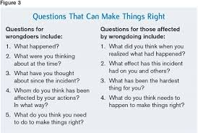

Slide 53
FGC Preparation
Personal visits with families of the offender and victims by justice coordinator prior to the convening of FGC
Make a victims' expectations more realistic
Ensure that victims are not intimidated or otherwise revictimized at the FGC

Slide 54
Court Referred RJ Conferences
Court justice coordinator or facilitator
Criteria –
  there was a direct victim
  the offense had a maximum sentence of at least two years imprisonment
  the offender had admitted guilt
  there was essential agreement about the facts underlying the case
Facilitator is responsible for contacting both the victim and the offender to see if they are agreeable to proceeding with a restorative justice conference
If agreed, conference is convened to bring together the offender and victim along with police, probation officers, lawyers and supporters of both victim and offender

Slide 55
Court Referred RJ Conferences
The focus of the conference is to discuss the criminal offense and how amends could be made
The facilitator is then responsible for writing a report of the conference and the conference agreements
The report and agreement will be forwarded to the court
Although the report is not binding on the court, the court would then consider the report in conjunction with deciding the disposition of the case and the sentence to be imposed, if any, on the offender

Slide 56
Court Referred RJ Pilot Programme
In June 2000, the New Zealand Government announced NZ$4.8 million in funding to introduce restorative justice conferences for adult offenders. In September 2000, the government announced that this pilot program would be conducted in four District Courts in Auckland, Waitakere, Hamilton and Dunedin.
This pilot restorative justice program will be used for persons who have committed offenses for which the maximum sentence is two years imprisonment.
A conference will be conducted only with the voluntary consent of the offender and of the victim. Conferences will be adjourned and supervised by two co-facilitators, who will be paid for their service. A written report from the conference will be prepared and forwarded to the sentencing court.
Four coordinators have been selected for each of the four courts

Slide 57
Victim-offender Mediation
victims of certain crimes and their offenders meet face-to-face to talk about the crime, to express their concerns, and to work out a restitution plan
In the late 1970s, only a handful of VOM and reconciliation programs existed.
Today, more than 250 programs operate throughout the United States
Although many VOM programs are administered by private, community-based agencies, an increasing number of probation departments are developing such programs, usually in conjunction with trained community volunteers who serve as mediators.
Victim services agencies are beginning to sponsor VOM programs as well.

Slide 58
Victim-offender Mediation
The first Victim Offender Mediation was initiated in the United States in Elkart, Indiana, in 1978.
After many years of supporting civil court mediation, the ABA in 1994 endorses the process and recommends the use of “victim-offender mediation and dialogue” in courts throughout the United States.
Victim-offender mediation programs frequently train community volunteers to serve as mediators
The average number of hours of training for staff or volunteer mediators is 31 hours
The average amount of time spent role playing the mediation process during training is 11 hours.

Slide 59
Victim Offender Mediation
In addition to the classroom training, the average number of cases that trainees are required to participate in with an experienced mediator, as a period of apprenticeship prior to completing their initial training, is four cases
In some of the states, mediators required certification

Slide 60
VOM Procedure
the victim and offender are telephoned prior to the mediation session
some are called by program staff and others are by the mediator.
Separate meetings are held with the victim and offender prior to the joint mediation session
offenders are required to admit their guilt to the specific offenses that led to their referral to the VOM program
victim participation in the mediation program is generally voluntary
victims can back out of the mediation program at any time
Offender participation in mediation is not entirely voluntary in all programs

Slide 61
VOM Procedure
Co-mediation is widely used in the field of victim-offender mediation
A brief opening statement by the mediator(s)
A typical VOM session begins with the parties “telling their stories” by describing what happened and the impact the event has had upon their lives
Then the offender will tell his/her story
The mediator (staff or volunteer) also can determine which party begins the storytelling phase of the mediation
Generally parents are present in the mediation

Slide 62
Tasks of Mediator
Facilitating a dialogue between the victim and offender
Making the parties feel comfortable and safe
Assisting the parties in negotiating a mutually acceptable plan for restitution for the victim
Active listening to both parties
Keeping a low profile so that the parties can talk directly to each other
Actively and efficiently moving the parties toward a written agreement

Slide 63
Location of Mediation Session
program offices
neighborhood and community centers
conference rooms in libraries
churches and temples

Slide 64
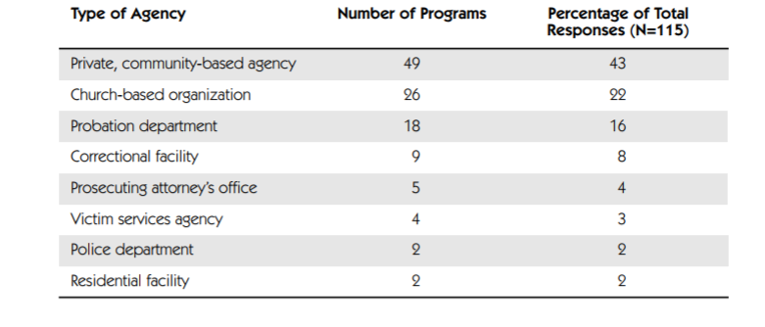
Type of Agencies Sponsoring Victim-Offender Mediation Programs in US

Slide 65
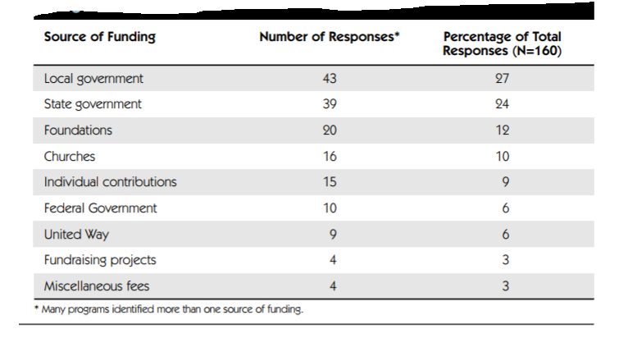
Primary Sources of Funding for Victim-Offender Mediation Programs

Slide 66
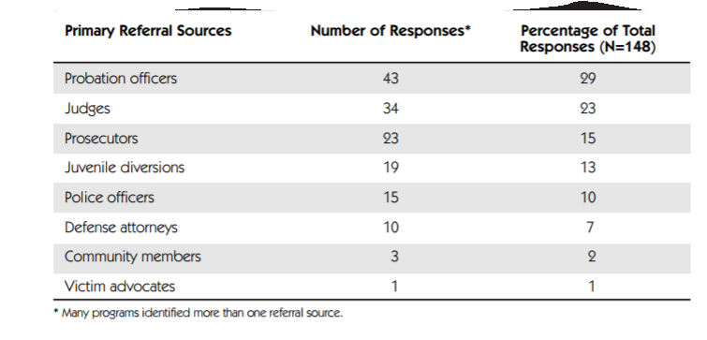
Primary Referral Sources for Victim-Offender Mediation Programs

Slide 67
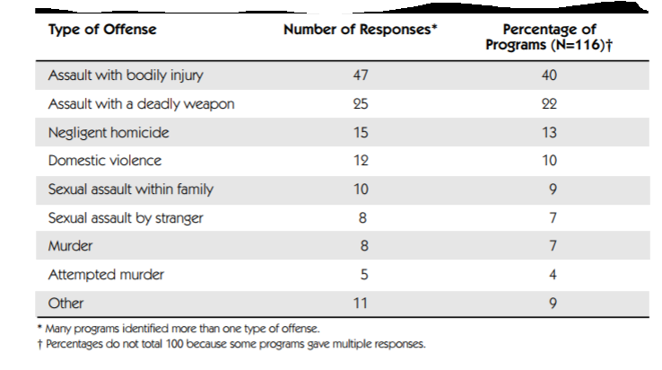
Occasional Referral of Severely Violent
Offenses

Slide 68
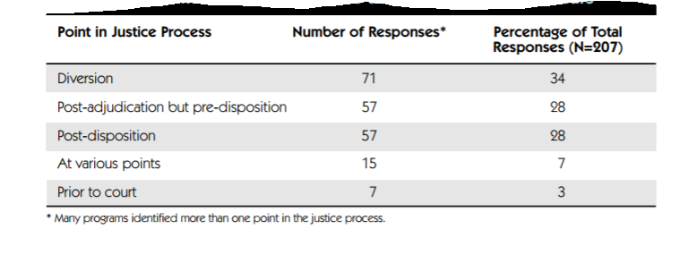
Point in the Justice Process at Which Mediation Occurs

Slide 69
Number of Victim Offender Mediation Programs, by Country
Australia 5
Austria 17
Belgium 31
Canada 26
Denmark 5
England 43
Finland 130
France 73
Germany 348
Italy 4
New Zealand Available in all jurisdictions Norway 44
South Africa 1
Scotland 2
Sweden 10
United States 289
National Survey of Victim-Offender Mediation Programs in the United States, US Department of Justice

Slide 70
Circle Conferencing
A type of restorative justice conferencing used in Canada
Initially used for aboriginal offenders, it is now applied to aboriginal and non-aboriginal offenders
Yukon Judge Barry Stuart convened the first circle conference in 1992 in the case of Philip Moses (Philip Moses was a 26 year-old member of the Na-cho Ny'ak Dun First Nation in Mayo, Yukon. He was found guilty of theft and of carrying a weapon for the purpose of committing an assault)
May be used for both adults and juveniles
It is part of court process and results in convictions and criminal records for offenders

Slide 71
Circle Sentencing Procedure
Chairs are arranged in a circle
The session is chaired by a respected member of the community, sometimes called 'the keeper of the circle' or by the judge
Usually between fifteen and fifty persons are in attendance
The participants in the circle introduce themselves
Then the charges are read and the crown and defence lawyers make brief opening remarks
The community members then speak
Participation is voluntary and everyone has an equal voice

Slide 72
Circle Conferencing Procedure
The discussions focus on more than just the offense and the offender and often include the following matters –
  The extent of similar crimes within the community
  The underlying cause of such crimes
  A retrospective analysis of what life in the community had been before crime became so prevalent
  The impact of these sorts of crimes on victims generally, on families and community life and the impact of this crime on the victim
  What can be done within the community to prevent this type of dysfunctional behaviour
  What must be done to help heal the offender, the victim and the community
  What will constitute the sentence plan
  Who will be responsible for carrying out the plan, who will support the offender and victim in ensuring the plan is successfully implemented
  A date to review the sentence

Slide 73
Circle Conferencing Procedure
Victims are notified in advance that an offender is seeking to use the circle sentencing process
Victim is assisted in establishing a support group and is encouraged to attend the hearing with his or her support group
Victim is a full and equal participant in a circle sentencing hearing
Circle sentencing discussions last from two to eight hours and frequently involve meetings on two separate dates
Often at the end of the first meeting, the offender is given a set of goals to determine if the offender can follow through with a plan before a final sentencing plan is imposed

Slide 74
Circle Conferencing Procedure
The circle will reconvene several weeks, or even months later, to review the offenders performance and make any necessary changes to the recommended plan
At that time, the judge will impose the final sentence incorporating the recommendations of the circle

Slide 75
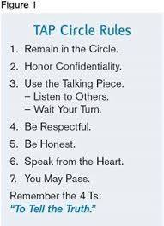

Slide 76
Effectiveness of RJ
(https://getrevising.co.uk/grids/restorative-justice)
85% satisfaction from victims perspective when taking part in face to face meetings
92.5% satisfaction from victims involved in violent crimes
reduced re offending. 11% re offending rates compared to control group with 37% re offending rates
An evaluation of victim satisfaction and perceptions of fairness at twelve different family-group conferencing sites in Minnesota found satisfaction levels with the process and outcome between 93% and 95%

Slide 77
Effectiveness of RJ
Roberts (1995) found that victims improved their relationships with friends and family members following a victim-offender mediation.
Umbreit, Coates, and Kalanj (1994) found that those offenders who had participated in mediation were more likely to be satisfied by the process (87% vs. 78%)
A study conducted in New Zealand found that 84% of offenders were satisfied with the outcome of their family-group conference (Morris & Maxwell, 1998)
Supporters of both victim and offender conference participants reported that the restorative justice programs created a greater sense of control and security in their community as well as restored harmony (Chaterjee, 1999)

Slide 78
Effectiveness of RJ
In Coates and Gehm's (1989) empirical assessment of victim-offender reconciliation programs, they found that 98% of victims and offenders agreed upon restitution. Of these agreements, there was a completion rate of 82% for financial restitution and 90% for service restitution.
In a national survey of 116 victim-offender mediation programs in the U.S., extensive phone interviews with program staff indicated that in 87% of cases a restitution agreement was reached, with a 99% completion rate (Umbreit, Fercello, & Umbreit, 1998).
In a comparison of two mediation programs matched with two court sites, Umbreit, Coates and Kalanj (1994) reported a restitution completion rate of 81% for mediated cases and 58% for court cases.

Slide 79
Effectiveness of RJ
An evaluation of victim satisfaction and perceptions of fairness at twelve different family-group conferencing sites in Minnesota found satisfaction levels with the process and outcome between 93% and 95%
considers the needs of the victim and how to help them
paid for by offenders - which is beneficial to community
Peace circles help the wider community not only those directly involved.

Slide 80
समस्या
पवित्राको श्रीमान बेपत्ता भएको ५ वर्ष भयो । पवित्राका ३ जना छोरा छोरी छन् । सबैको उमेर ६ देखि १० वर्ष रहेको छ । जसोतसो ज्याला मजदुरी गरेर लालन पालन गरेका छन् । यसै बीच पवित्राले परपुरुषसंगको सम्बन्धबाट गर्भ धारण गर्न पुगेकी रहिछिन् । समाजको लोकलाजको कारण जातक जन्मे पछि हत्या गरेर खाल्डोमा पुरेर छोडेकी रहिछन् । पछि उजुरी परी अनुसन्धान हुँदा पवित्रा कसूरमा सावित भइन् । कानून बमोजिम सर्वस्व सहित जन्मकैद हुने व्यवस्था छ । तर यसो गर्दा उनका छोरा छोरीको लालन पालन कसले गरिदेला भन्ने प्रश्न पनि छ । यो समस्यालाई हाम्रो न्याय प्रणालीले सम्वोधन गर्न सक्ने अवस्था होला ?

Slide 81
राममाया राई वि श्री ५ को सरकार
नेकाप २०६६ नि नं ८२२० पृ १४७७
प्रतिवादीको तीन नावालक बच्चाहरू भएको र बाबु विदेश गएको कारण निर्दोष नावालक बच्चाहरू हेरचाह विहीन अवस्थामा Orphan सरह रहेको कारणले गर्दा प्रतिवादीलाई सजाय घटाई जेलमुक्त गर्दा ती तीन नावालक बच्चाहरूको हेरचाह संरक्षण लालन पालन शिक्षा दिक्षा हुने कारणले गर्दा प्रतिवादीलाई अ.वं. १८८ नं. को आधारमा सजाय घटाउदा न्याय पर्नजाने देखिएकोले अ.वं. १८८ नं. बमोजिम प्रतिवादीलाई आज सम्म कैद बसेको दुई वर्ष आठ महिना चौविसदिन मात्र कैदको सजाय हुने ठहर्छ ।
पुनरावेदिकालाई निजको तीन वटा नावालक बच्चाहरू भएको र निज बच्चाहरूको लालनपालन हेरचाह गर्ने अभिभावक नभएको कारण अ.वं. १८८ बमोजिम पुनरावेदिकालाई कैद सजाय घटाइएकोले कैदमुक्त भएपछि आफ्नो नावालक बच्चाहरूको आमाको हैशियतले गर्नुपर्ने हेरचाह लालनपालनको कर्तव्यहरू गर्नु भनी सुनाई दिनु

Slide 82

Implementing RJ in Police Dept https://www.researchgate.net/publication/254266846_Implementing_restorative_justice_in_police_departments
Research Report, Texas University

Slide 83
Restorative Justice Council in UK
“Restorative justice face to face meetings mediated by police officers…improved perceptions of the criminal justice system, including the police”
“It is clear that, done well, restorative justice cannot be done to (or even for) victims, it must be done with them”
- Garry Shewan, ACPO Lead on Restorative and Community Justice

Slide 84
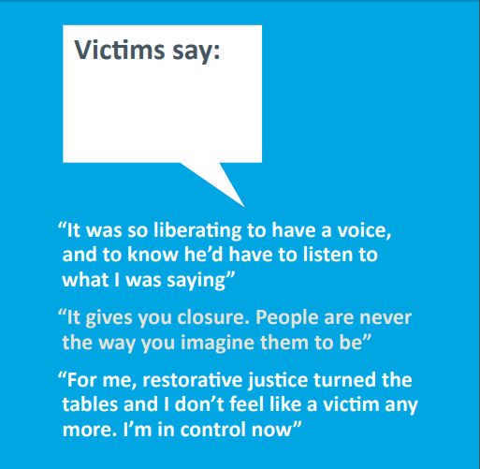

Slide 85
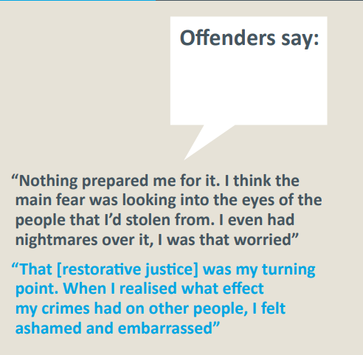

Slide 86
Can police facilitate restorative justice at every level?
Although the police are able to facilitate restorative justice in all the levels mentioned above, the majority of cases facilitated by police officers are for low level crime and antisocial behaviour. Below are some of the ways police can use restorative justice for these lower level crimes

Slide 87
UK Police
Out of court disposals : Out of court disposals are a category of ways of dealing with usually low level and often first time offending in a proportionate way that does not require taking the offender to court.
Community remedy: Recently introduced, the community remedy gives victims of low level crime a say in how the police deal with their offender.
Community resolutions: Community resolution is a type of out of court disposal used by the police to deal with low level crime and antisocial behaviour. In a community resolution, a restorative meeting between victim and offender, which the police officer facilitates, may take place at the scene of the offence to deal with low level crime effectively and proportionately.

Slide 88
Criticism
Restorative Justice is not panacea
Restorative justice has no role, for example, in punishing the offender or in deterring others from crime
You can’t get blood from a stone.
community involvement is questionable. It may undermine the interest of victims
Is justice subjective ?

Slide 89
According to Morris https://www.quora.com/What-are-the-best-arguments-against-Restorative-Justice
restorative justice erodes legal rights;
restorative justice trivializes crime (particularly men's violence against women);
restorative justice fails to "restore" victims and offenders;
restorative justice fails to effect real change and to prevent recidivism;
restorative justice results in discriminatory outcomes;
restorative justice leaves power imbalances untouched;
restorative justice leads to vigilantism;
restorative justice lacks legitimacy and restorative justice fails to provide "justice"

Slide 90
Criticism
Albert W. Dzur and Susan M. Olson argue that professionals are often left out of the restorative justice conversation.
Gregory Shank and Paul Takagi see restorative justice as an incomplete model in that it fails to fix the fundamental, structural inequalities that make certain people more likely to be offenders than others.
Do victims get compensation that is in line with their losses, or is it more a question of symbolic reparation, which, more often than not, consists of community service or work for third parties?
Are the victims satisfied when the reparation is limited to an apology or is geared mainly toward the re-education of the offender?

Slide 91
Criticism
Restorative justice aims to resolve conflict and restore dialogue between the parties where possible. Is such dialogue desired or desirable in all cases?
A significant number of victims refuse to be part of a meeting (Reeves; 1989; Law Commission of Canada, 2003)
The question of fear of retaliation
Research shows some victims feel very angry because they have been cast aside by social agencies or the criminal justice system. Still others feel the damage is beyond repair.

Slide 92
Offenders' Perspectives
If think from the perspective of offenders, a path that is not always smooth and easy. They will be asked to prove that they want to change and mend their ways
Making an emotional commitment, revealing their true selves and dealing with shame and blame are not easy things to do. Offenders are not accustomed to expressing that level of emotion, even with the people closest to them.
Many offenders may use restorative justice for all sorts of purposes: avoiding punishment, casting themselves in a better light, playing down their faults, even taking pride in their relationship with the victim (Van Giseghem, 2003; Hudson, 2003).

Slide 93
Many Questions to be considered
What cases are relevant ?
What types of victim and offender are more likely to benefit from a meeting?
How and why should they be involved?
How can the individual characteristics of each case be taken into account?
In what way and at what point in time is the participation of victims desirable and appropriate at the various stages of the penal procedure?

Slide 94
Criticism
not available to all offenders, only those who have admitted their crime but victims may reject the offer. therefore cannot be a global solution
psychological harm may be brought to the victim especially if the criminal shows no empathy towards them which may result in a lowered self esteem
additionally, the offender may be harmed, the victims may gang up on the offender which is especially dangerous if the offender is a child.
victims may attempt to shame the offender which is not the aim of the process

Slide 95
At the End
Restorative justice has not yet changed the basic course of the criminal justice system. It has proven to be a more effective alternative to prison or other forms of punishment, but has produced mitigated results in terms of victim participation and reparation for injury
While its objectives may be laudable, restorative justice is nevertheless a disaggregated model. Combining relational justice, participative or consensual justice and transforming or reforming justice, restorative justice has become a catchall concept that has something for everyone.
Restorative justice has great potential for the parties involved and for the community. However, it is not the magic solution to all evils. It remains an option for some crimes in some circumstances and under some conditions. It must not be considered a cheap form of justice or pretend justice.

Slide 96
बाल न्याय प्रणालीमा पुनस्थापकीय न्यायको
अवधारणाको प्रयोगको सम्भावना

Slide 97
प्रयोगको सम्भावना
अपराध पीडितलाई सामाजिक पुनस्थापना र क्षतिपूर्ति सहितको न्याय पाउने हक हुने – संविधानको धारा २१(२) र अपराध संहिता दफा ३२(२)
सजायको उद्देश्यमा "कसूरदारलाई आफ्नो कार्यप्रति पश्चाताप बोध गराई पीडित व्यक्ति वा समुदायलाई हानि नोक्सानी भएको छ भन्ने कुराको अनुभूति गराउने" – सजाय निर्धारण ऐनको दफा १३(च)
कुनै कसूरका सम्बन्धमा क्षतिपूर्ति लिने दिने सम्बन्धमा पीडित र कसूरदारले कुनै सहमति गर्न सक्नेछन् ।सहमति मनासिब देखिए अदालतले त्यस्तो सहमति बमोजिमको क्षतिपूर्तिको आदेश गर्न सक्नेछ – सजाय निर्धारण ऐनको दफा ४४

Slide 98
प्रयोगको सम्भावना
बाल न्याय सम्पादन गर्दा पुनस्थापकीय न्यायको मान्यता अनुकूल हुने गरी गर्नु पर्ने – बालबालिका सम्बन्धी ऐन, २०७५ को दफा ३९(१)
अपराध पीडित संरक्षण ऐन, २०७५ को दफा १६ – पीडित र अभियुक्त दुवैको सहमतिमा कसूरसंग सम्बन्धित विषयमा अदालतले छलफल गराउन सक्ने
आफूले गरेको कसूर स्वीकार गरी पीडितलाई क्षतिपूर्ति दिइसकेको वा दिन मञ्जुर गरेको विषय कसूरको गम्भीरता घटाउने आधार हुने – अपराध संहिताको दफा ३९(छ)

Slide 99
नेपालमा प्रयोगको सम्भावना
सजाय छुटको प्रस्ताव राख्न सक्ने – फौ का संहिता दफा ३३ र अपराध संहिता दफा ४७
सानातिना कसूरमा भविष्यमा त्यस्तो कसूर नगर्ने कबुलियत गराएर मुद्दा दायर नगर्न सकिने (तर मन्यावको स्वीकृति लिई सरकारी वकिलले) – फौ का संहिता दफा ३४ ।तर यस्तोमा चित्त नबुझे पीडित पक्षले मुद्दा दायर गर्न सक्ने

Slide 100
प्रयोगको सम्भावना
कसूरजन्य कार्य स्वीकार गरेको अवस्थामा ५हजारसम्म विगो भएको वा २ हजारसम्म जरिवाना हुने वा १ महिनासम्म कैद हुनसक्नेमा अनुसन्धान अधिकारीले दिशान्तर गर्न सक्ने – बालबालिका सम्बन्धी ऐन, २०७५ को दफा २७ र २८
दिशान्तर गर्दा बालबालिकालाई पीडितसंग मेलमिलाप वा समझदारी कायम गराउने – बालबालिका सम्बन्धी ऐन, २०७५ को दफा २९(१)(क)

Slide 101
प्रयोगको सम्भावना
दिशान्तर गर्दा पीडित पक्षको यथसम्भव पुनर्स्थापना हुने गरी निजको सहमति प्राप्त भएको हुनु पर्ने – बालऐन दफा २८(ग)
दिशान्तर गर्दा बालबालिकाको इच्छा समेतलाई बिचार गरी पीडितसंग मेलमिलाप वा समझदारी कायम गराउने – बालऐन दफा २९(१)(क)
दिशान्तर गर्दा पीडितलाई क्षतिपूर्ति दिने वा वास्तविक हानी नोक्सानी भराइ दिनु पर्ने – बालऐन दफा २९(८)
कसूरदारले आफूले गरेको कसूर स्वीकार गरी पीडितलाई दिन मंजुर गरे कसूरको गम्भीरता घटाएको मानिने – मुअसं दफा ३९(छ)
Victim-offender mediation

Slide 102
धन्यवाद

Slide 103
कानूनी व्यवस्थाहरु
तीनवर्ष भन्दा कम कैदको सजाय हुने कुनै कसूर गर्ने व्यक्तिलाई कैदको सजाय नगरी पहिलो पटक कसूरदार ठहरी अड्डाले कैदमा राख्न मनासिब नठहराएमा एक दिनको पच्चिस रुपैयाँको दरले हुन आउने रकम तोकी सो तोकिएको रकम बुझाएमा कसूरदारलाई कैदमा नराख्ने गरी अड्डाले फैसला गर्न सक्नेछ । सो बमोजिम कसूरदारले रुपैयाँ बुझाएमा बुझिलिई कैदको लगत कट्टा गरी दिनुपर्छ – दण्डसजायको ११ क (२)
माथि दफा २ बमोजिम फैसला गर्दा अड्डाले कसूरदारसंग फेरि त्यस प्रकारको कुनै अपराध नगरी राम्रो आचरण पालन गर्नेछु भनी कागज गराउनेछ – दण्डसजायको ११ क (३)

Slide 104
श्री ५ को सरकार वि लोप्साङ् नोर्वु लामा
नेकाप २०६४ नि नं ७८४५ पृ ५७६
मुद्दा : सरकारी छाप दस्तखत किर्ते
प्रतिवादी : विदेशी र किर्ते गरी नागरिकता निकालेको
जि अ बाट दण्डसजायको ११क प्रयोग गरी कैदमा बस्न नपर्ने गरी फैसला भएकोमा सर्वोच्च अदालत बाट यस्तो मुद्दामा ११क प्रयोग गर्न नमिल्ने फैसला

Slide 105
कानूनी व्यवस्थाहरु
अपराध पीडितलाई सामाजिक पुनस्थापना र क्षतिपूर्ति सहितको न्याय पाउने हक हुने – संविधानको धारा २१(२) र अपराध संहिता दफा ३२(२)
कसूर स्वीकार गरी पीडितलाई क्षतिपूर्ति दिइसकेको अवस्थालाई कसूरको गम्भीरता घटाउने अवस्थाको रुपमा व्यवस्था – अपराध संहिताको दफा ३९(छ)
अन्तरिम क्षतिपूर्ति – अपराध संहिताको दफा ४८
पीडितलाई कसूरदारबाट क्षतिपूर्ति भराइदिनुपर्ने व्यवस्था – अपराध संहिताको दफा १२७, १३६, १८६ आदि

Slide 106
पीडितको सुरक्षाको प्रबन्ध – फौजदारी कार्यविधि संहिताको दफा ११४
पीडितको परिचय गोप्य राखिने - फौजदारी कार्यविधि संहिताको दफा १८३
सजायको उद्देश्यमा "कसूरदारलाई आफ्नो कार्यप्रति पश्चाताप बोध गराई पीडित व्यक्ति वा समुदायलाई हानि नोक्सानी भएको छ भन्ने कुराको अनुभूति गराउने" – सजाय निर्धारण ऐनको दफा १३(च)
क्षतिपूर्तिलाई असर नपर्ने गरी जरिवाना निर्धारण गर्नुपर्ने – सजाय निर्धारण ऐनको दफा १९
कैद सजायको निलम्वन गर्दा "कसूरबाट पीडित व्यक्तिको कुनै काममा सहयोग गर्ने" आदेश दिन सकिने – सजाय निर्धारण ऐनको दफा २४(४))ख)

Slide 107
कुनै कसूरका सम्बन्धमा क्षतिपूर्ति लिने दिने सम्बन्धमा पीडित र कसूरदारले सहमति गर्न सक्नेछन् – सजाय निर्धारण ऐनको दफा ४४(१)

